Slide 1


Slide 2

Classification of Research Articles Using NLP and Machine learning

Slide 3
Group Members Introduction
Group ID: S2302A8683
Muhammad Shamaas MC220204248

Slide 4

INTRODUCTION OF PROJECT
In this project, research articles will be classified into six categories based on their title and abstract. Four Machine Learning (ML) algorithms will be used to train the Natural Language Processing (NLP) model. By recognizing key features of the technical jargon, the model will be able to classify any research paper into most suitable category. This will make it easier to classify large volumes of research articles without having to read each one separately.

Slide 5
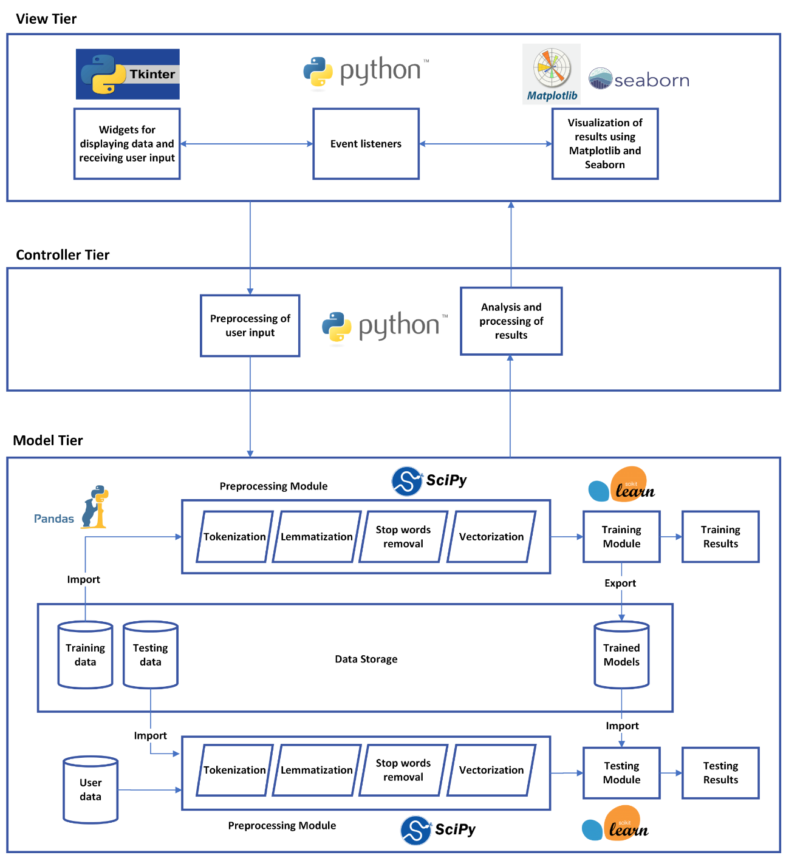
Architecture Diagram

Slide 6
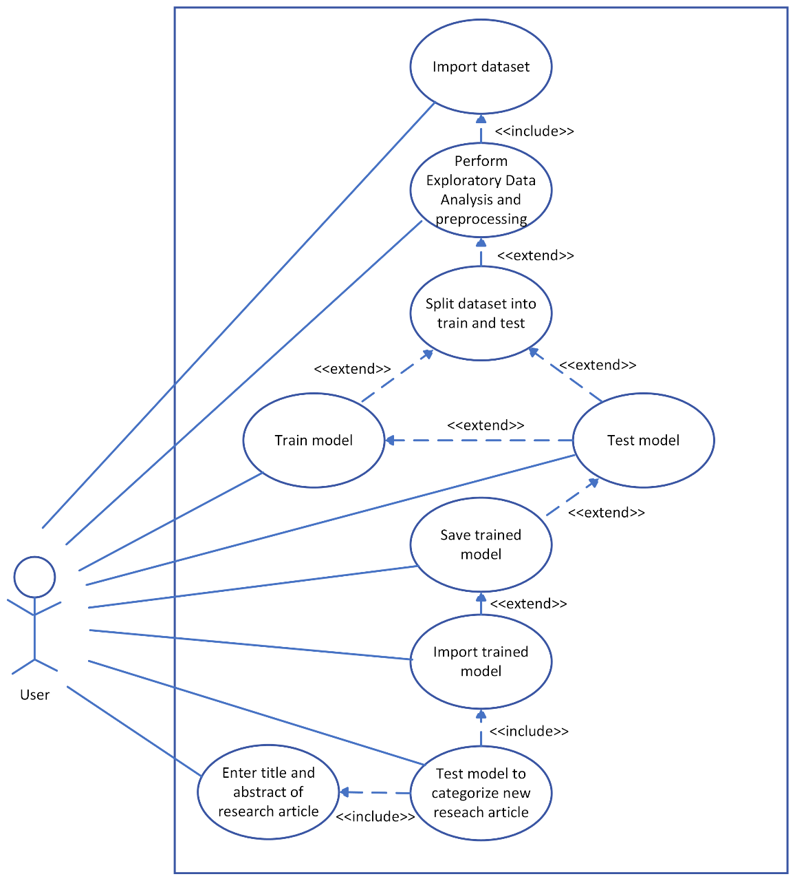
Use Case Diagram

Slide 7
Business Rules Catalog
Import the dataset.
Perform Exploratory Data Analysis (EDA).
Preprocess the data.
Split the data into train and test.
Use supervised machine learning to train the model.
Evaluate the trained model on the test data.
Save the trained model.
Develop User Interface window.
Integrate the trained model with the user interface.
Test complete application.

Slide 8
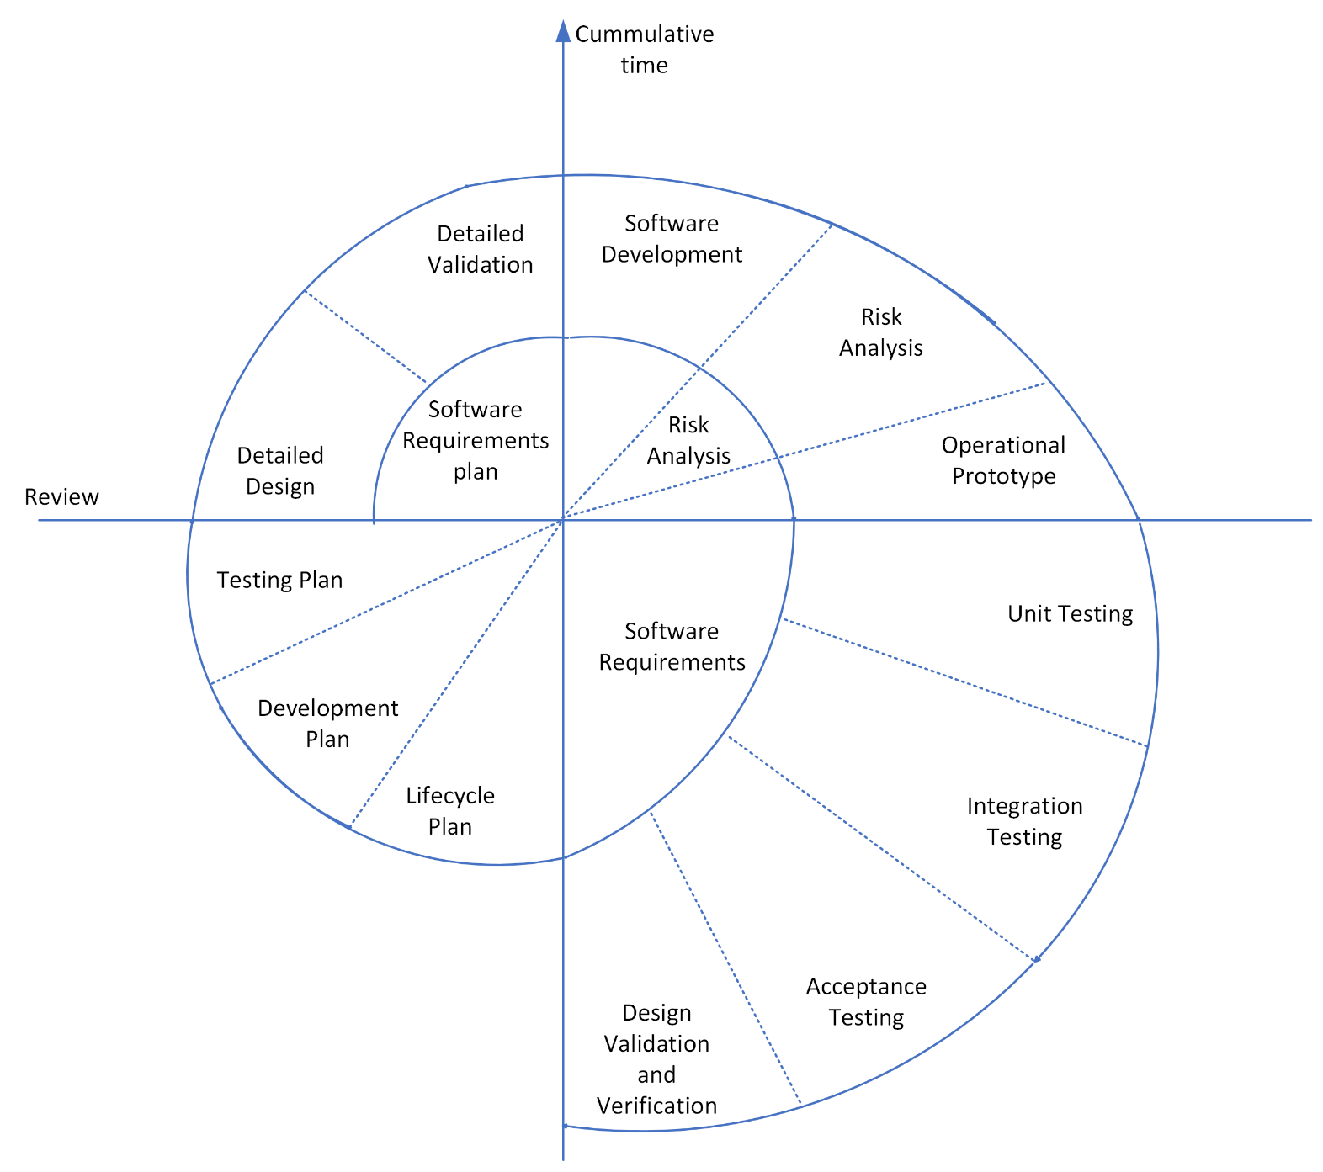
Adopted Methodology

Slide 9
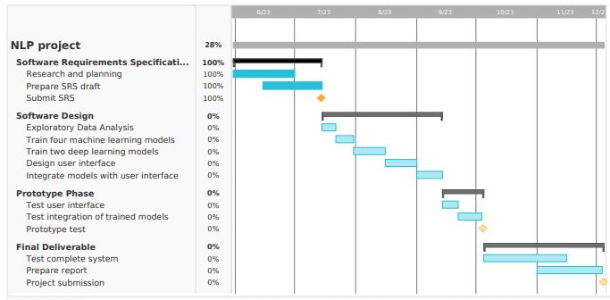
Project Schedule

Slide 10
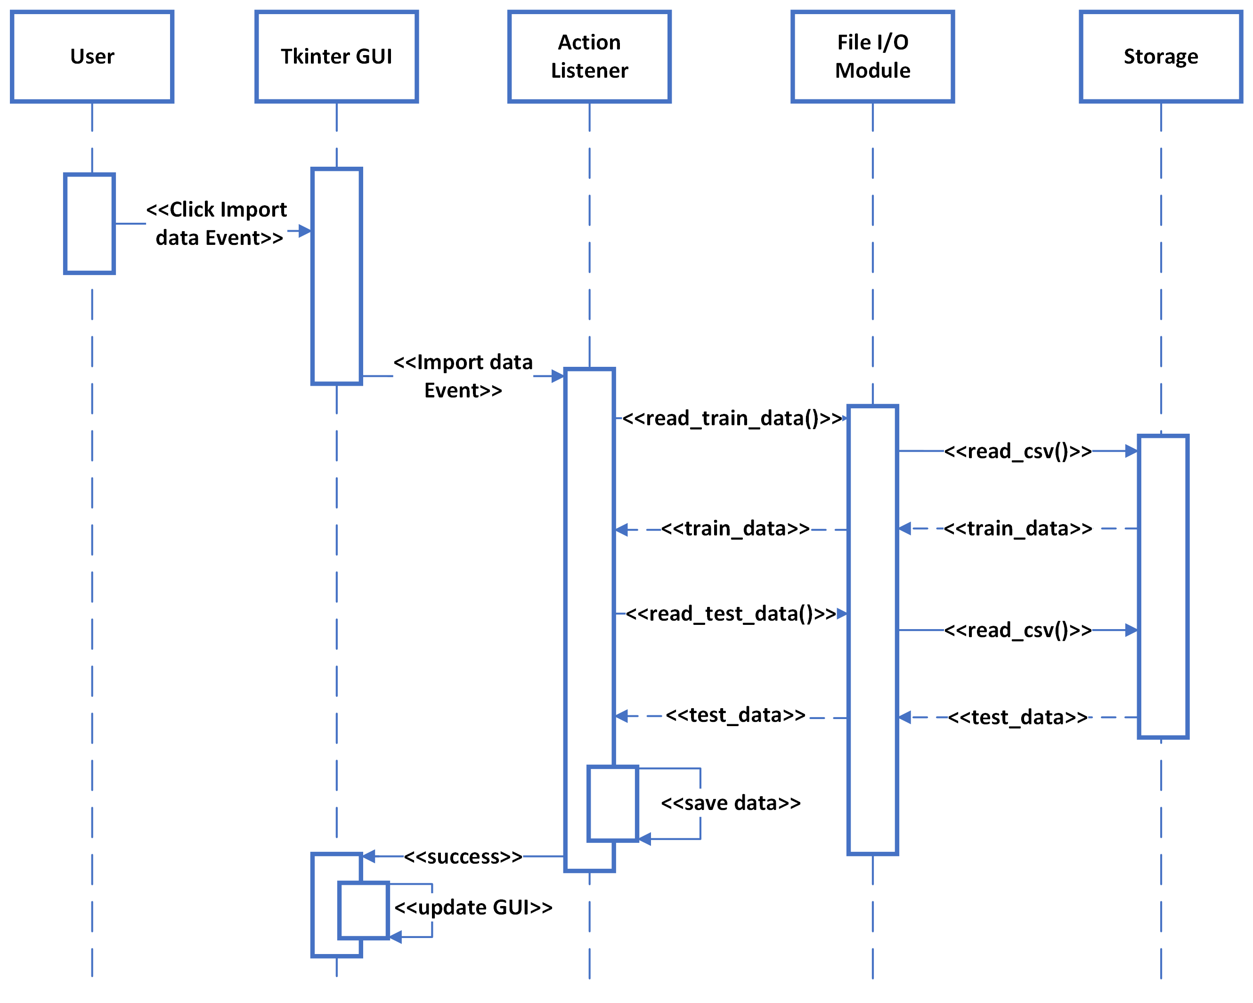
Import Training Data
Sequence Diagrams

Slide 11
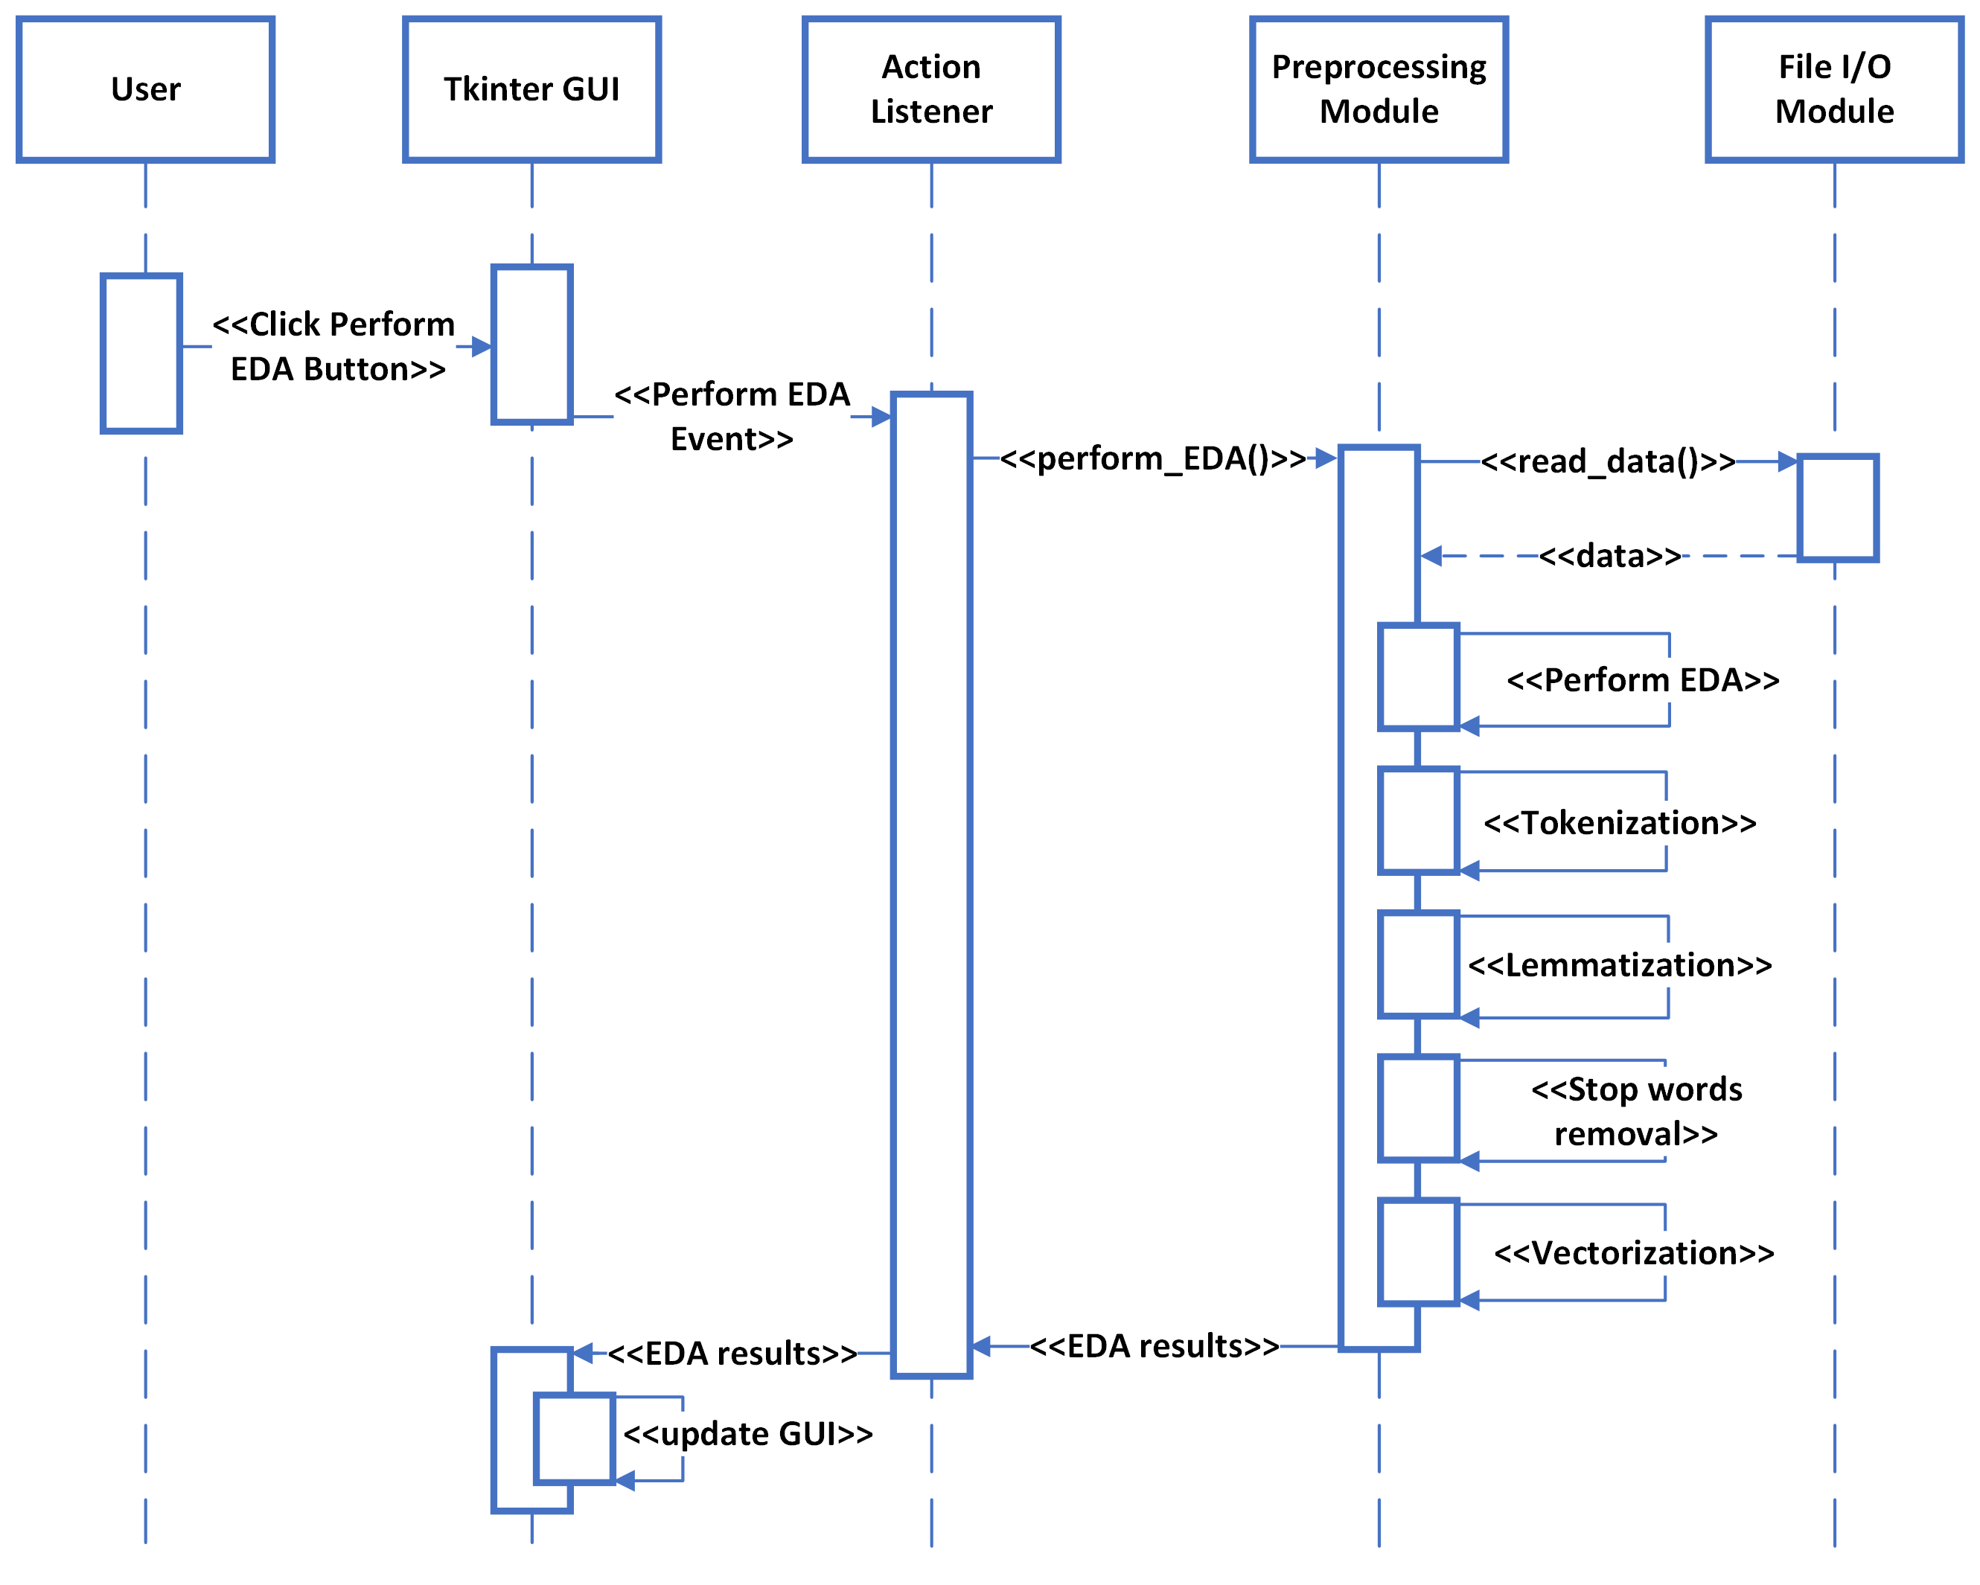
Data Preprocessing
Sequence Diagram

Slide 12
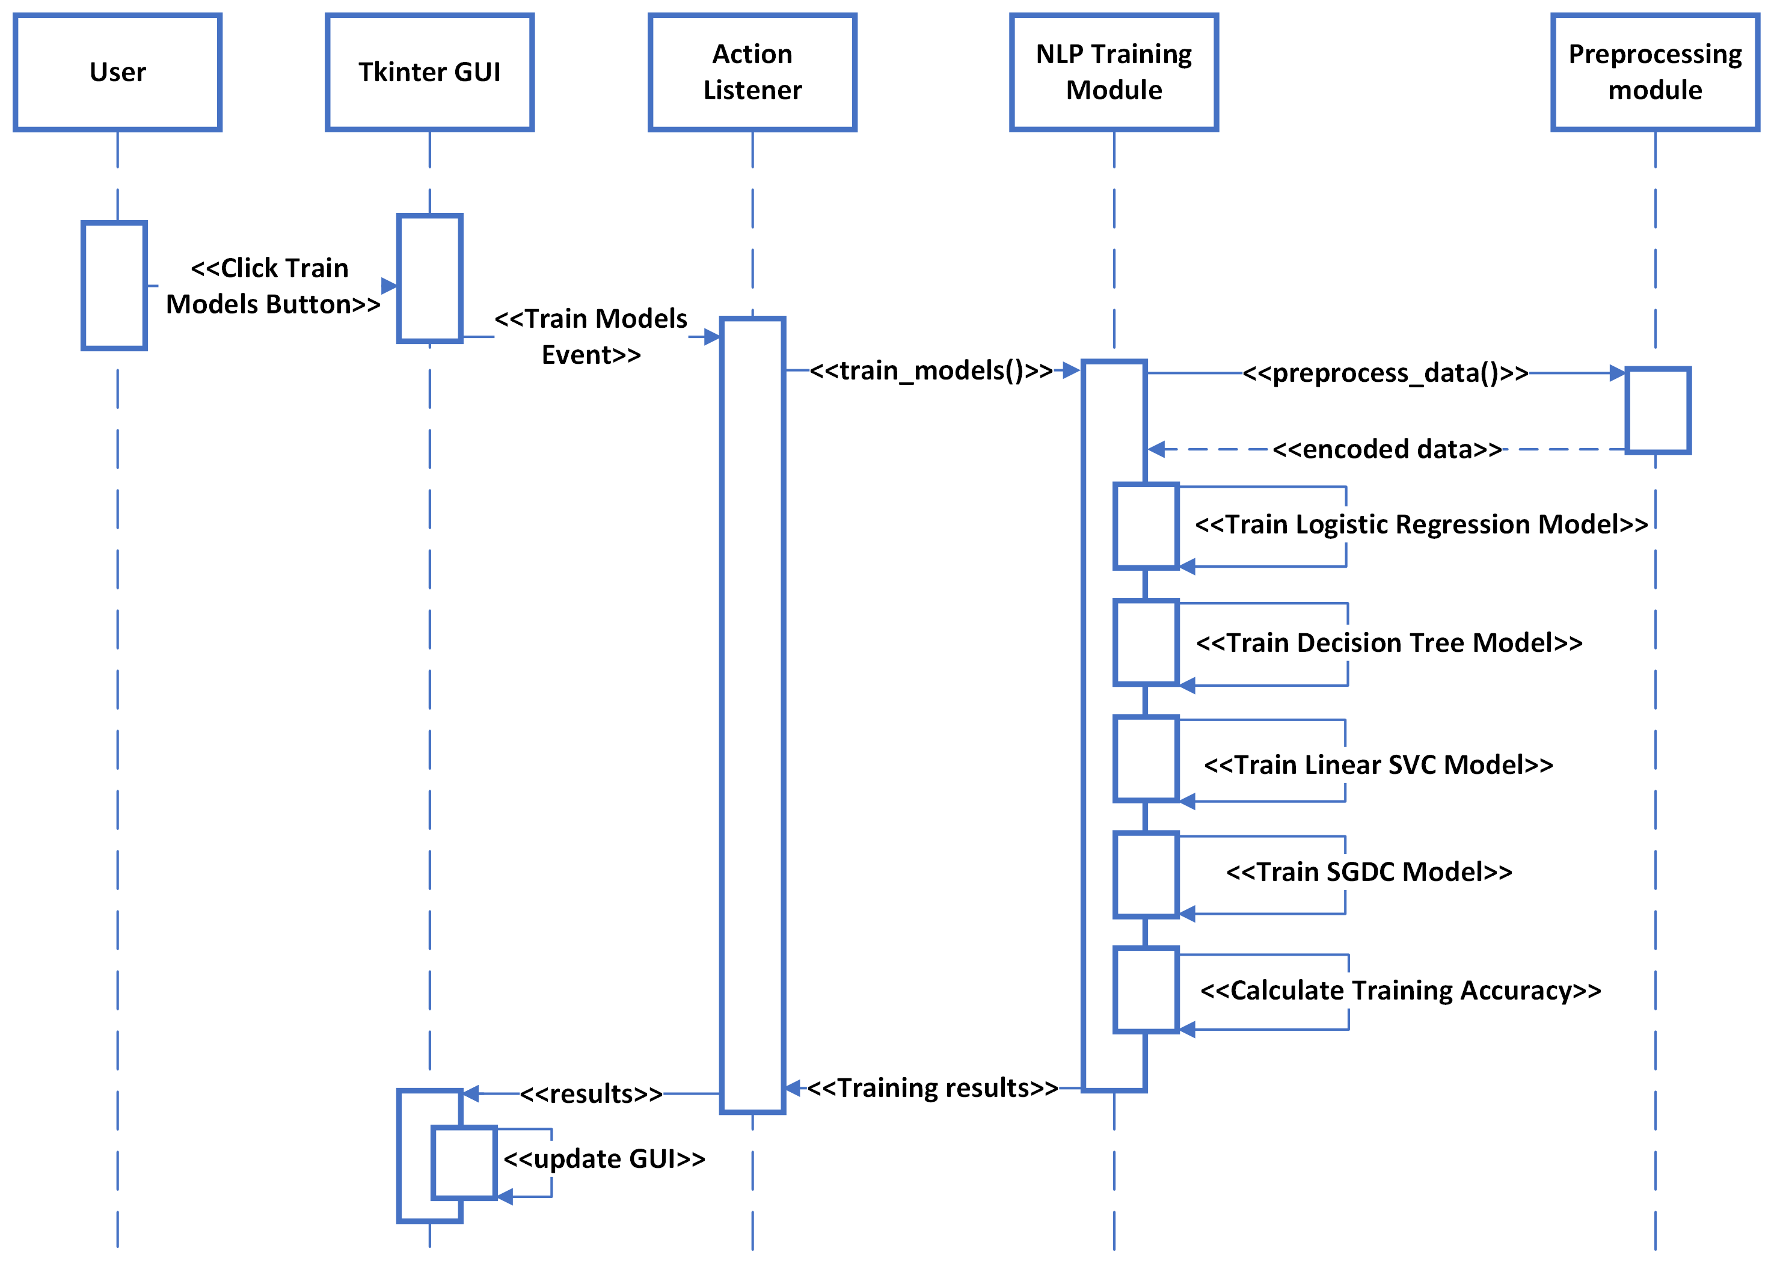
Model Training
Sequence Diagram

Slide 13
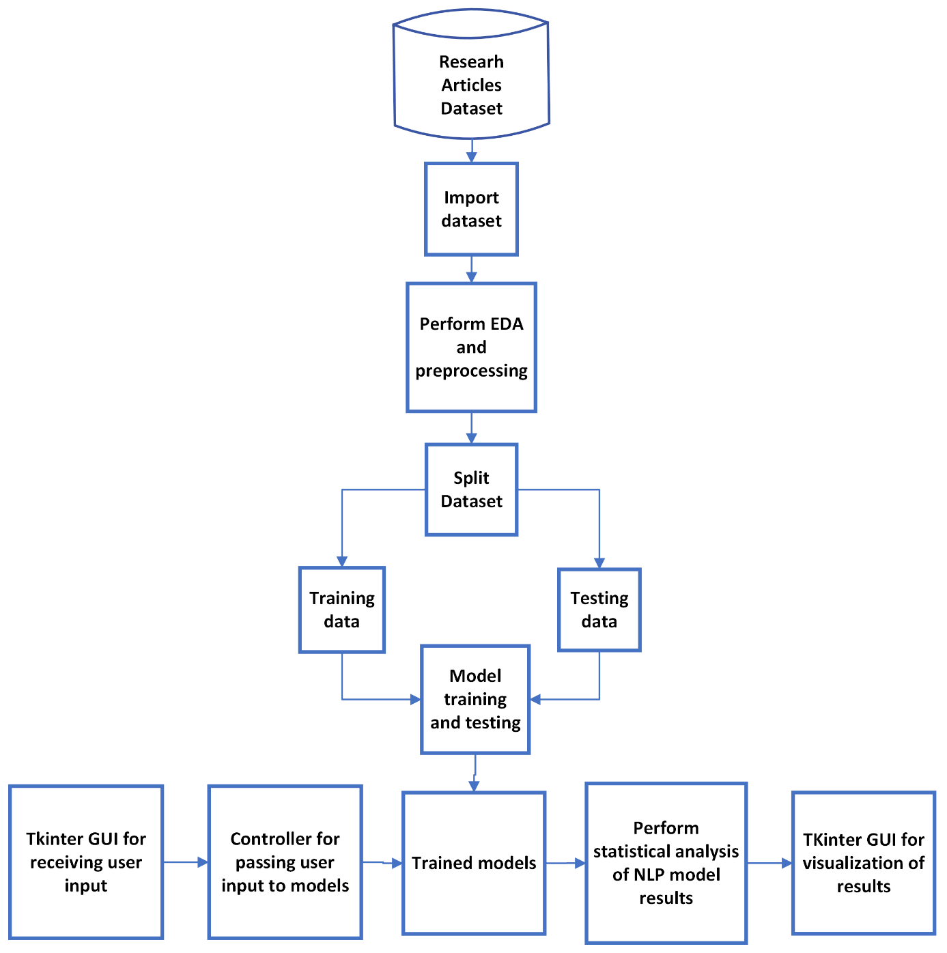
Logical Model

Slide 14
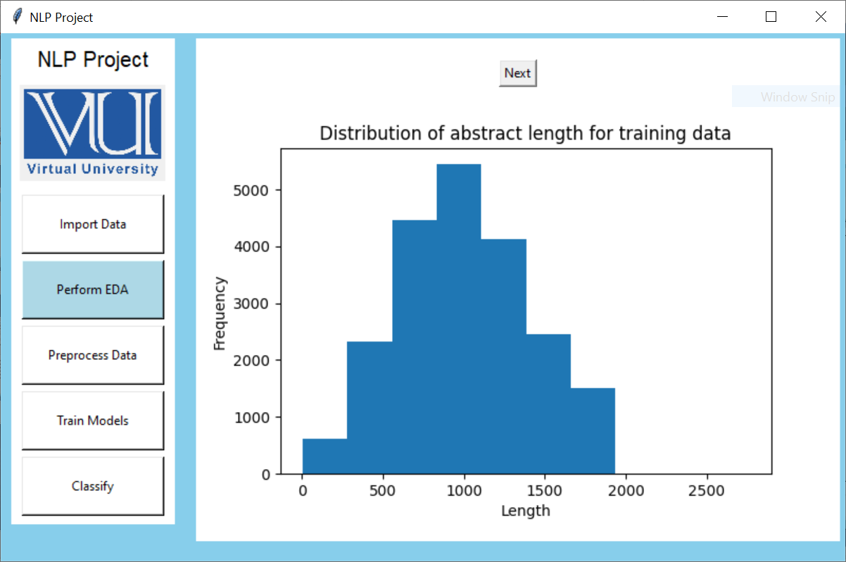
User Interfaces

Slide 15
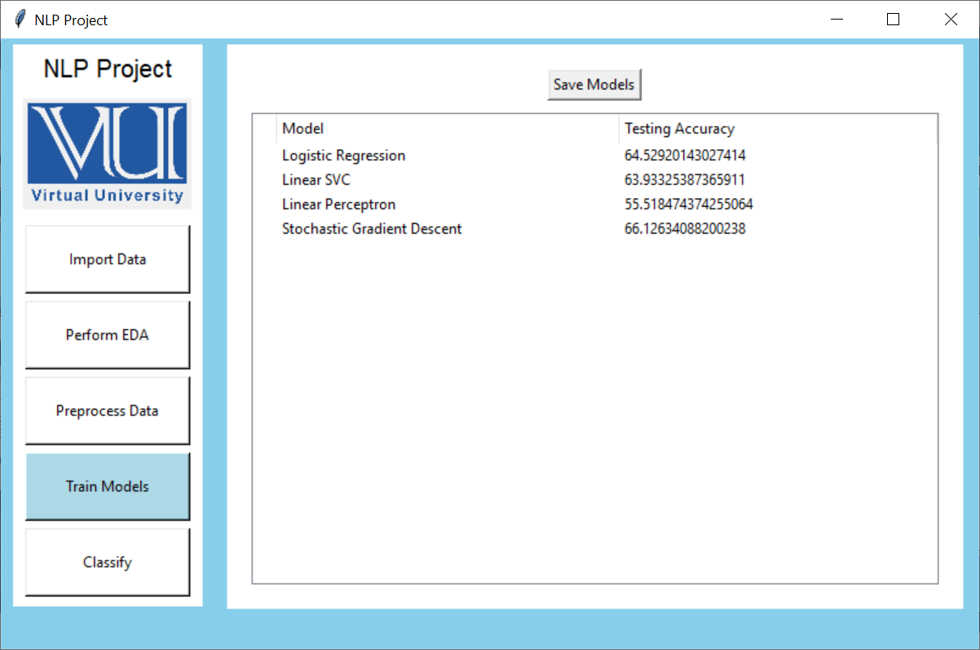
User Interfaces

Slide 16
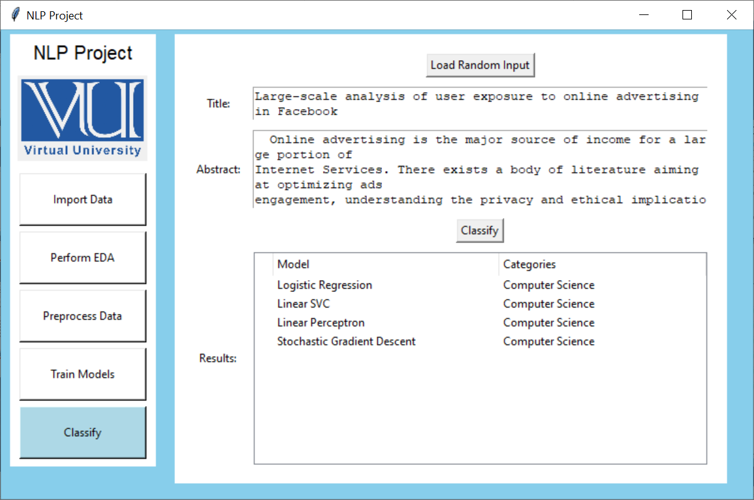
User Interfaces

Slide 17
Tools
Tkinter
Matplotlib
SciPy
Scikit-learn
Pandas

